Slide 25
Measuring Central Black-Hole Masses
Virial mass measurements based on motions of stars and gas in nucleus.
  Stars
    Advantage: gravitational forces only
    Disadvantage: requires high spatial resolution
      larger distance from nucleus ⇒ less critical test
  Gas
    Advantage: can be observed very close to nucleus, high spatial resolution not necessarily required
    Disadvantage: possible role of non-gravitational forces (radiation pressure)

Slide 26
Direct vs. Indirect Methods
Direct methods are based on dynamics of gas or stars accelerated by the central black hole.
  Stellar dynamics, gas dynamics, reverberation mapping
Indirect methods are based on observables correlated with the mass of the central black hole.
  M_{BH}–σ* and M_{BH}–L_{bulge} relationships, fundamental plane, AGN scaling relationships (R_{BLR}–L)

Slide 27
“Primary”, “Secondary”, and “Tertiary” Methods
Depends on model-dependent assumptions required.
Fewer assumptions, little model dependence:
  Proper motions/radial velocities of stars and megamasers (Sgr A*, NGC 4258)
More assumptions, more model dependence:
  Stellar dynamics, gas dynamics, reverberation mapping
    Since the reverberation mass scale currently depends on other “primary direct” methods for a zero point, it is technically a “secondary method” though it is a “direct method.”

Slide 28
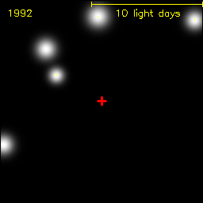
The Center of the Milky Way
Infrared observations of stars suggested a dark massive object.
  Mid-80s: radial velocities
  90s: add proper motions
  Sgr A* BH mass of 3.6 ×10⁶ M.
Genzel group at MPE Garching
Ghez group at UCLA

Slide 29
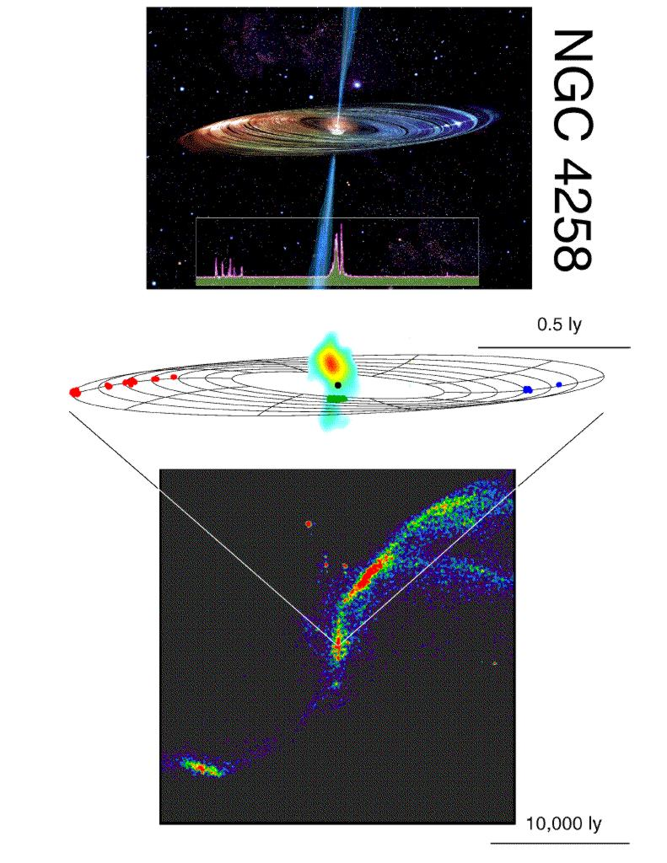
Observing Supermassive Black Holes
The first reliable measurement of a supermassive black hole mass in an AGN Miyoshi et al. (1995)
Detection of H₂0 maser sources orbiting a BH of mass 3.78 ×10⁷ M.
  Requires special geometry, so only a handful of BH masses measured this way.

Slide 31
Virial Estimators for AGNs
Mass estimates from the
virial theorem:
M = f (r ΔV ² /G)
where
r = scale length of
region
ΔV = velocity dispersion
f = a factor of order
unity, depends on
details of geometry
and kinematics
In units of the Schwarzschild radius
R_{S} = 2GM/c² = 3 × 10¹³ M₈ cm .

Slide 32
Reverberation Mapping
Emission line variations follow those in continuum with a small
time delay (14 days here) due to light-travel time across the
line emitting region.
Grier et al. 2012a, ApJ, 744, L4

Slide 33
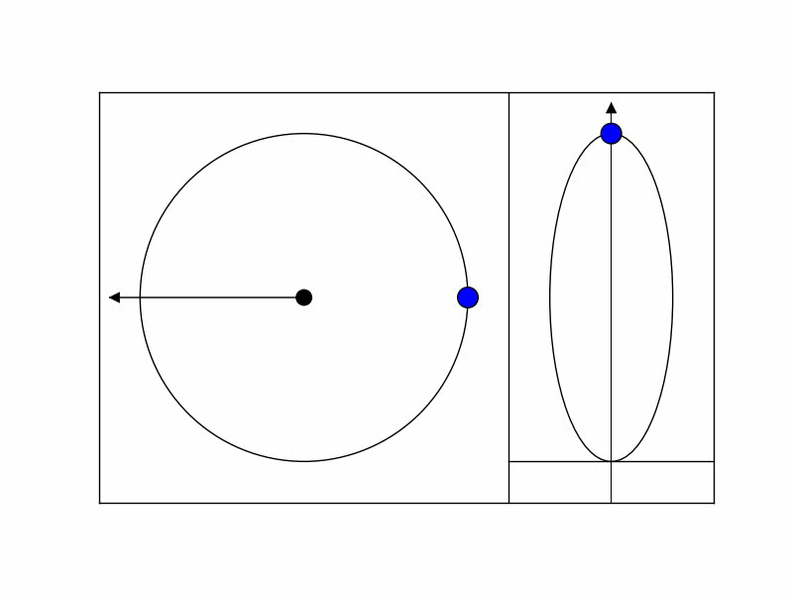
Velocity-Delay Map
Configuration
space
Velocity-Delay
space
To observer
Time delay
Doppler velocity

Slide 34
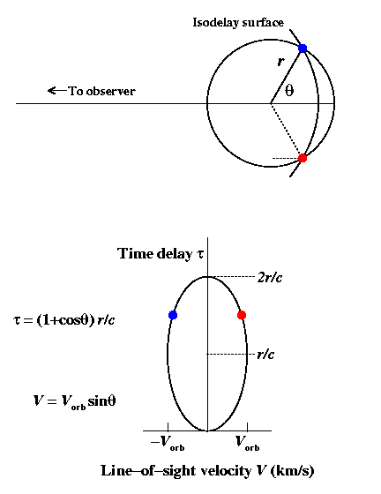
Velocity-Delay Map for an Edge-On Ring
Clouds at intersection of isodelay surface and orbit have line-of-sight velocities V = ±V_{orb} sinθ.
Response time is τ = (1 + cos θ)r/c
Circular orbit projects to an ellipse in the (V, τ) plane.

Slide 35
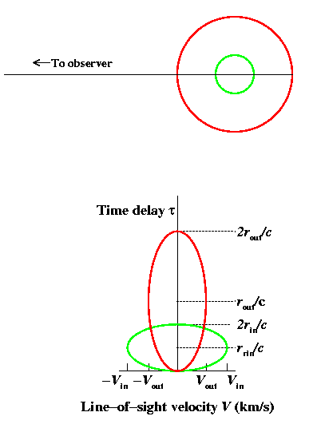
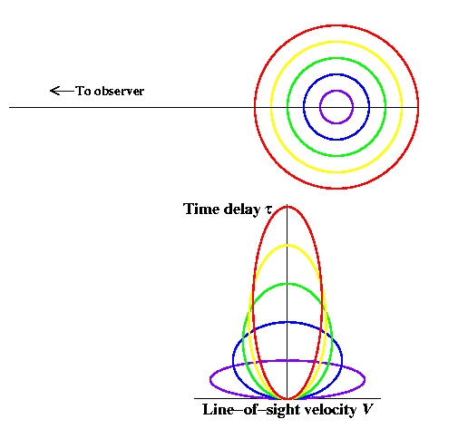
Thick Geometries
Generalization to a disk or thick shell is trivial.
General result is illustrated with simple two ring system.
A multiple-ring system

Slide 36
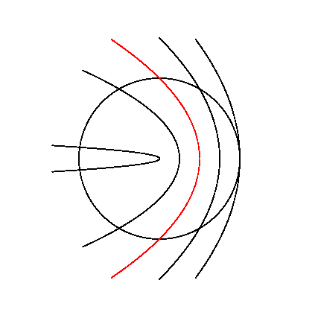
“Isodelay Surfaces”
All points
on an “isodelay
surface” have
the same extra
light-travel time
to the observer,
relative to photons
from the continuum
source.
τ = r/c
τ = r/c

Slide 37
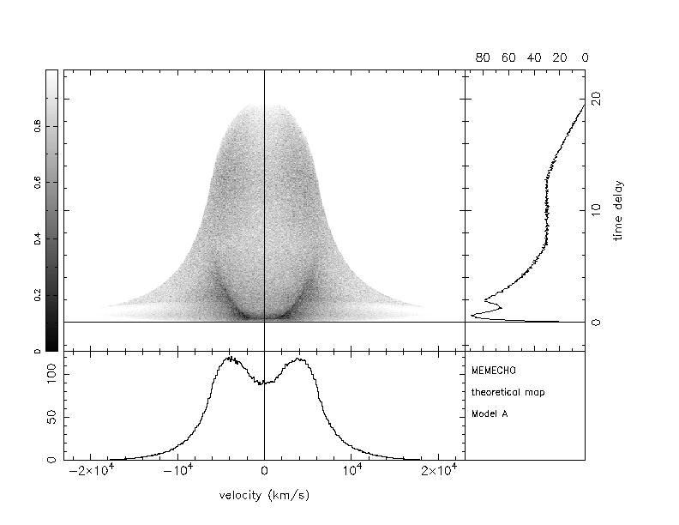
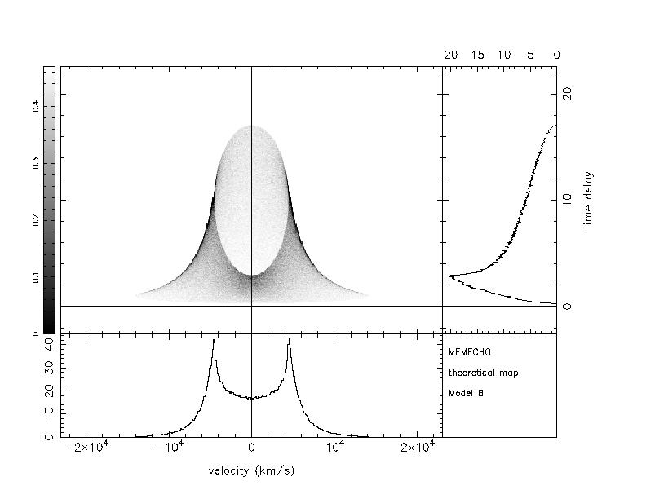
Two Simple Velocity-Delay Maps
Inclined Keplerian
disk
Randomly inclined
circular Keplerian orbits
The profiles and velocity-delay maps are superficially similar,
but can be distinguished from one other and from other forms.

Slide 38
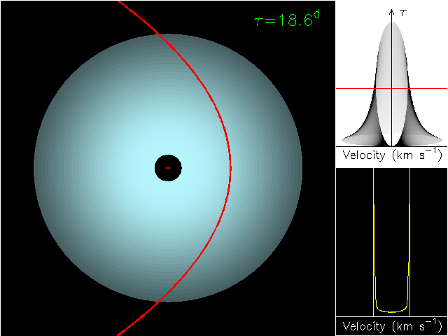
Time after continuum outburst
“Isodelay surface”
Time
delay
20 light days
Broad-line region
as a disk,
2–20 light days
Line profile at
current time delay
Black hole/accretion disk

Slide 39
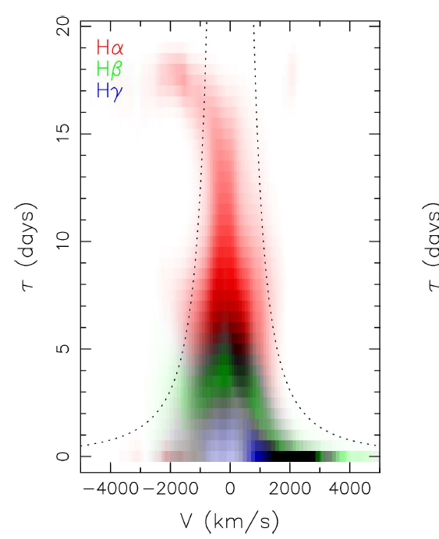
Reverberation Response of an Emission Line to a Variable Continuum
The relationship between the continuum and emission can be taken to be:
Velocity-resolved
emission-line
light curve
“Velocity-delay map”
Continuum
light curve
Velocity-delay map is observed line
response to a δ-function outburst
Arp 151
LAMP: Bentz et al. 2010

Slide 40
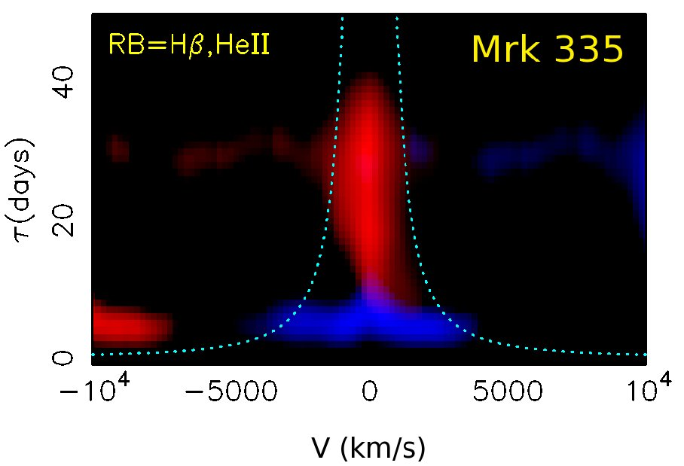
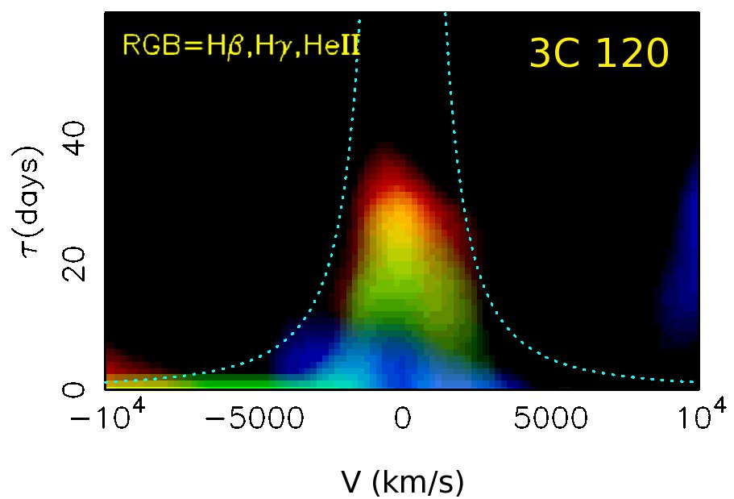
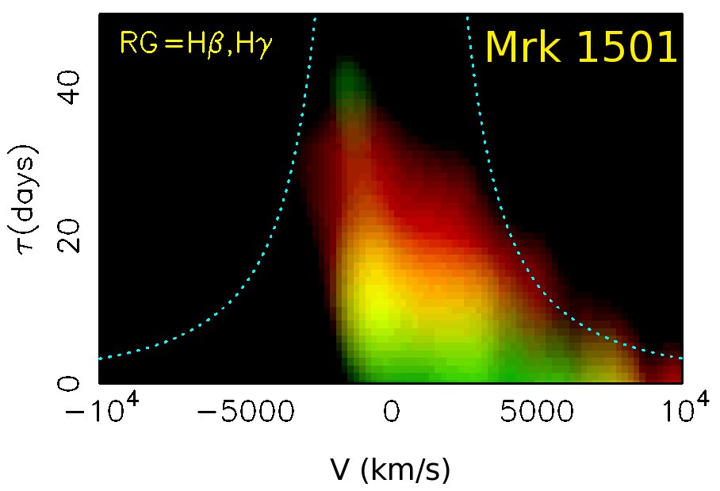
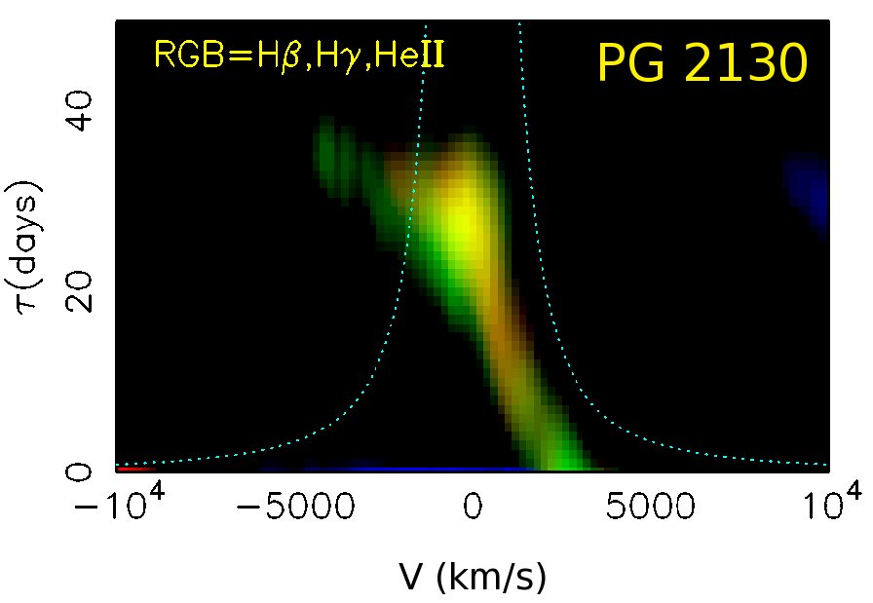
Optical Velocity Delay Maps Show Infall in Balmer Lines
Grier et al. 2012c, submitted to ApJ

Slide 41
A Complex Multicomponent Broad-Line Region?

Slide 42

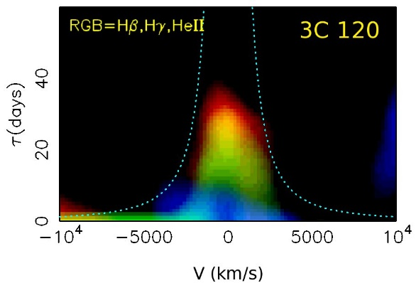
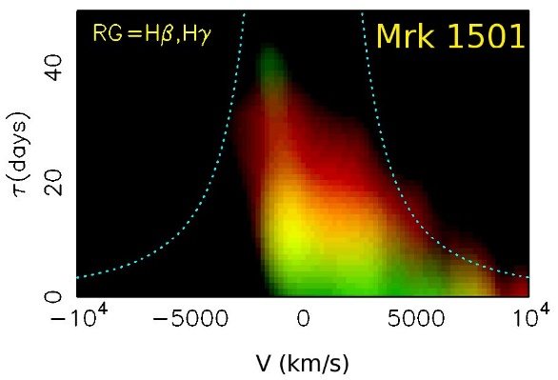
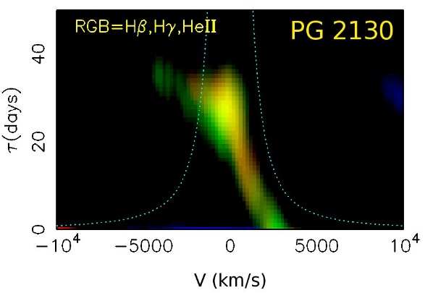
Toy Models
Grier et al. 2012c, submitted

Slide 43
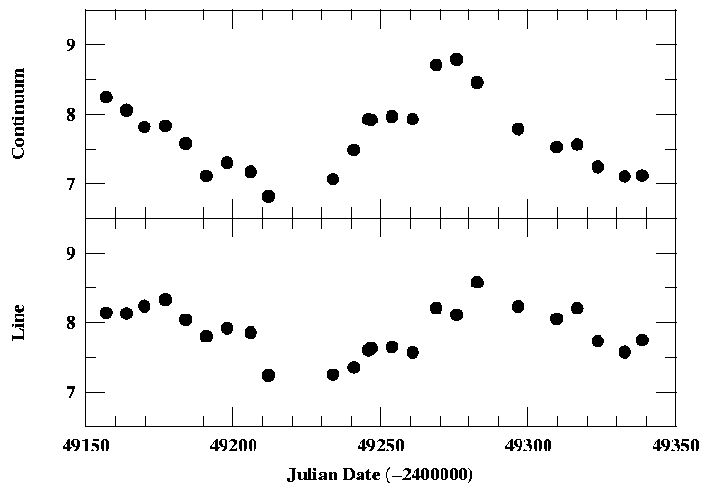
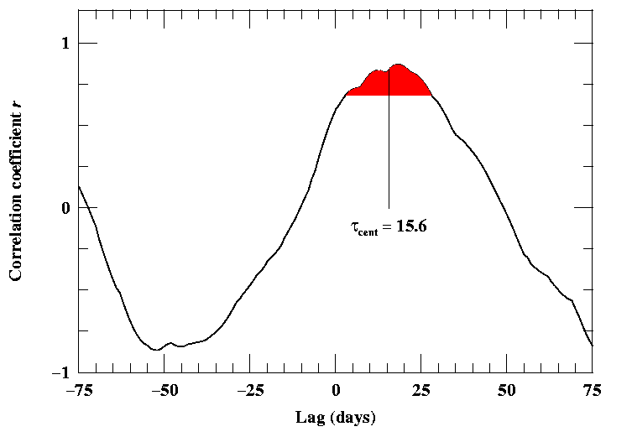
Emission-Line Lags
Because the data requirements are relatively modest,
it is most common to determine the cross-correlation
function and obtain the “lag” (mean response time):

Slide 44
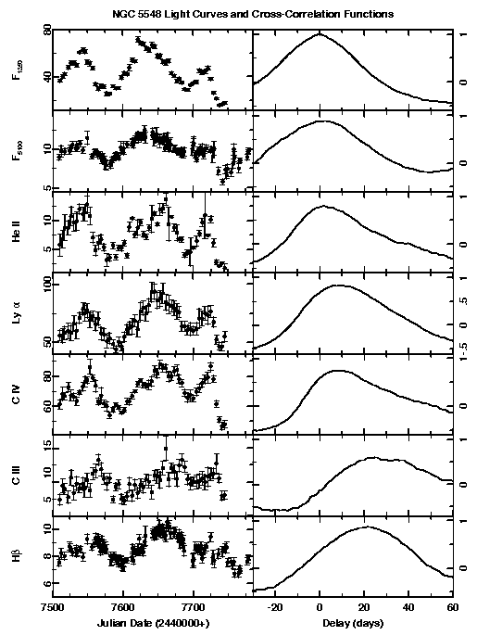
Reverberation Mapping Results
Reverberation lags have been measured for nearly 50 AGNs, mostly for Hβ, but in some cases for multiple lines.
AGNs with lags for multiple lines show that highest ionization emission lines respond most rapidly  ionization stratification

Slide 45
Measuring the Emission-Line Widths
We preferentially measure line widths in the rms residual spectrum.
  Constant features disappear, less blending.
  Captures the velocity dispersion of the gas that is responding to continuum variations.
Grier et al. 2012b, ApJ, 755:60

Slide 46
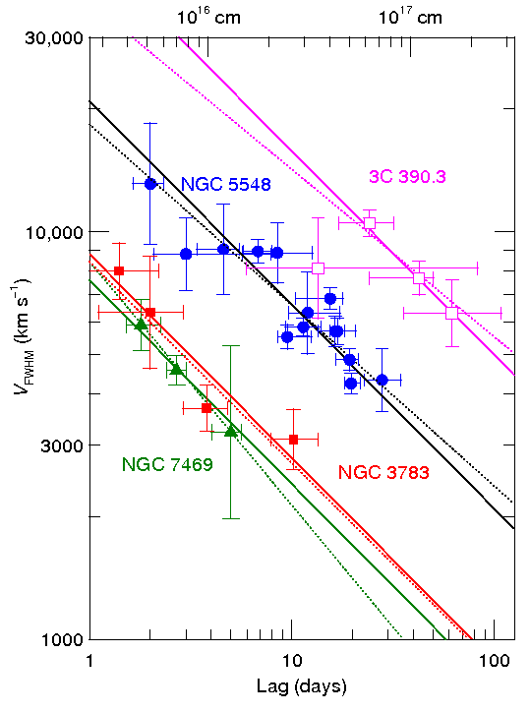
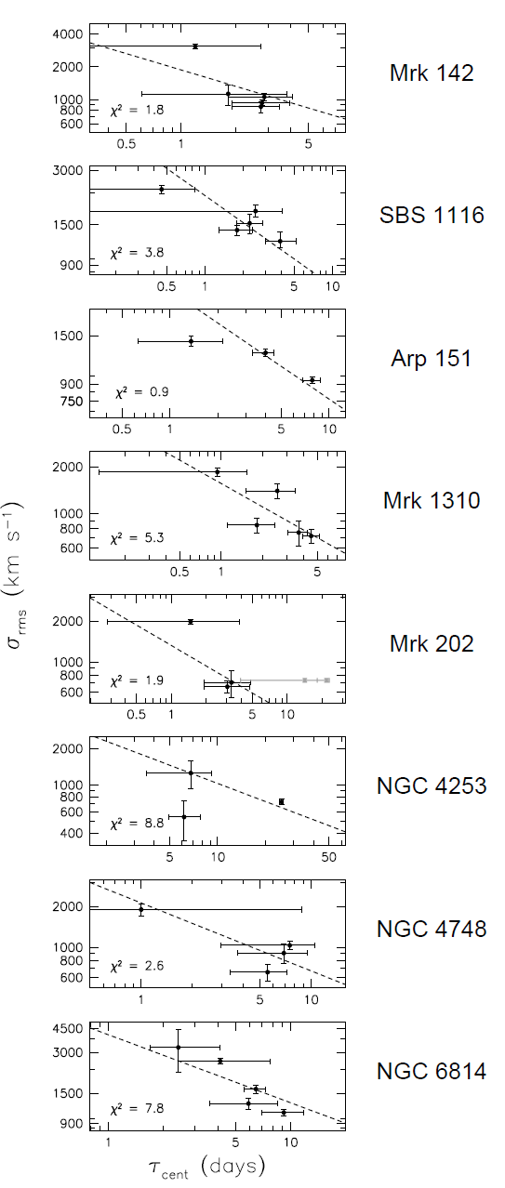
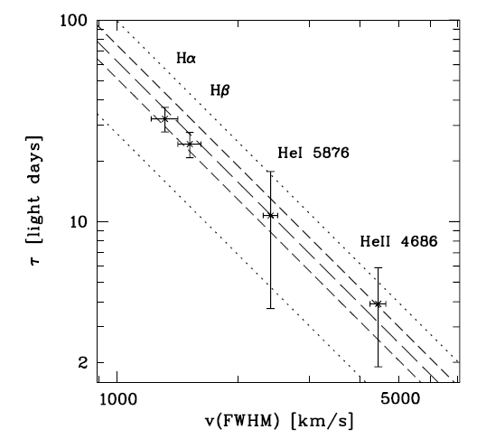
A Virialized BLR
ΔV ∝ R ^{–1/2} for every AGN in which it is testable.
Suggests that gravity is the principal dynamical force in the BLR.
  Caveat: radiation pressure!
Peterson & Wandel 2002
Mrk 110
Bentz et al. 2009
Kollatschny 2003

Slide 47
Reverberation-Based Masses
“Virial Product” (units of mass)
Observables:
r = BLR radius (reverberation)
ΔV = Emission-line width
Set by geometry and inclination
(subsumes everything we don’t know)
If we have independent measures of M_{BH}, we
can compute an ensemble average <f >

Slide 48
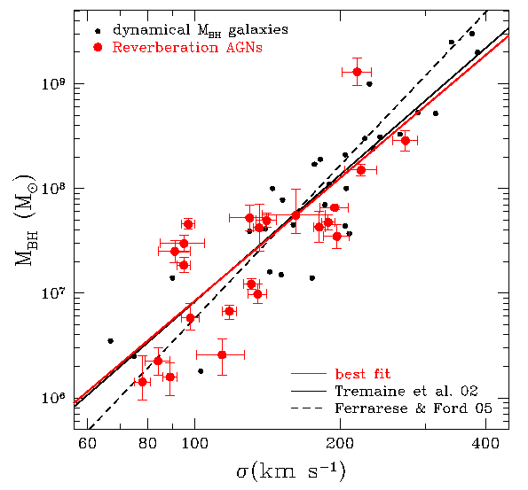
The AGN M_{BH}–σ* Relationship
Assume slope and zero point of most recent quiescent galaxy calibration.
⟨f ⟩ = 5.25 ± 1.21
  Woo et al. 2010
Maximum likelihood places an upper limit on intrinsic scatter Δlog M_{BH} ~ 0.40 dex.
  Consistent with quiescent galaxies.
Woo et al. 2010

Slide 49
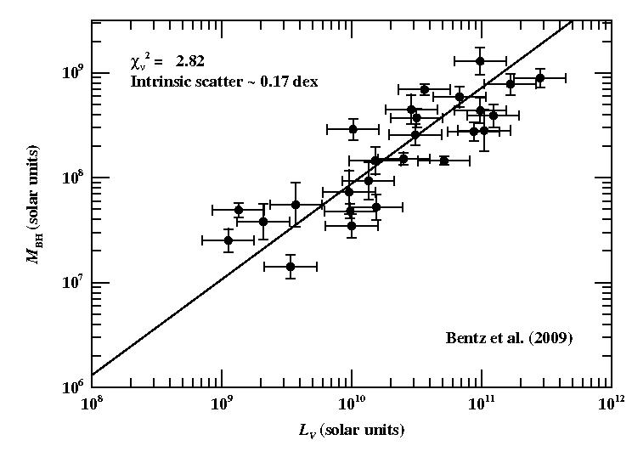
The AGN M_{BH}–L_{bulge} Relationship
Line shows best-fit to quiescent galaxies
Maximum likelihood gives upper limit to intrinsic scatter Δlog M_{BH} ~ 0.17 dex.
  Smaller than quiescent galaxies (Δlog M_{BH} ~ 0.38 dex).

Slide 50
Black Hole Mass Measurements (units of 10⁶ M)
Galaxy | NGC 4258 | NGC 3227 | NGC 4151
Direct methods:
Megamasers | 38.2 ± 0.1 | N/A | N/A
Stellar dynamics | 33 ± 2 | 7–20 | < 70
Gas dynamics | 25 – 260 | 20⁺¹⁰₋₄ | 30^{+7.5}₋₂₂
Reverberation | N/A | 7.63 ± 1.7 | 46 ± 5
Quoted uncertainties are statistical only, not systematic.
References: see Peterson (2010) [arXiv:1001.3675]

Slide 51
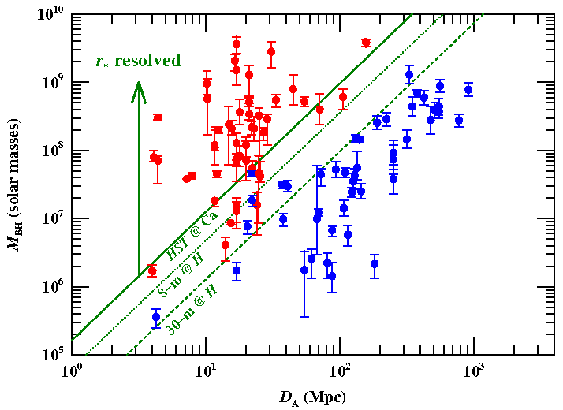
Masses of Black Holes in AGNs
Stellar and gas dynamics requires higher angular resolution to proceed further.
  Even a 30-m telescope will not vastly expand the number of AGNs with a resolvable r*.
Reverberation is the future path for direct AGN black hole masses.
  Trade time resolution for angular resolution.
  Downside: resource intensive.
To significantly increase number of measured masses, we need to go to secondary methods.

Slide 52
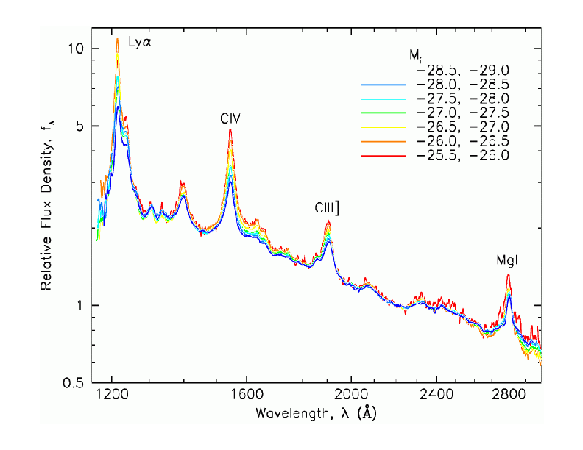
BLR Scaling with Luminosity
To first order, AGN
spectra look the same
Same ionization
parameter U
Same density n_{H}
r  L^{1/2}
SDSS composites, by luminosity
Vanden Berk et al. 2004
Kris Davidson 1972

Slide 53
Measurement of Central Black Hole Masses
Phenomenon:
Quiescent
Galaxies
Type 2
AGNs
Type 1
AGNs
Direct
Methods:
Stellar, gas
dynamics
Stellar, gas
dynamics
Megamasers
Megamasers
2-d
RM
2-d
RM
1-d
RM
1-d
RM
Fundamental
Empirical
Relationships:
M_{BH} – σ*
AGN M_{BH} – σ*
Indirect
Methods:
Fundamental
plane:
Σ_{e}, r_{e} ⇒ σ*
⇒ M_{BH}
[O III] line width
ΔV ⇒ σ* ⇒ M_{BH}
Broad-line width ΔV
& size scaling with
luminosity
R ∝ L^{1/2} ⇒ M_{BH}
Application:
BL Lac
objects
Low-z AGNs
High-z AGNs

Slide 54
Black Hole Mass Measurements (units of 10⁶ M)
Galaxy | NGC 4258 | NGC 3227 | NGC 4151
Direct methods:
Megamasers | 38.2 ± 0.1 | N/A | N/A
Stellar dynamics | 33 ± 2 | 7–20 | < 70
Gas dynamics | 25 – 260 | 20⁺¹⁰₋₄ | 30^{+7.5}₋₂₂
Reverberation | N/A | 7.63 ± 1.7 | 46 ± 5
Indirect Methods:
M_{BH}–σ* | 13 | 25 | 6.1
R–L scaling | N/A | 15 | 65
References: see Peterson (2010) [arXiv:1001.3675]

Slide 55
Black Hole Masses
All direct methods have systematic uncertainties at the factor of 2 level (at least!).
  NGC 4258 (megamasers) and Galactic Center are exceptions
Ignoring zero-point uncertainties, the prescriptions for AGN masses are probably believable at the 0.5 dex level.
If we desire higher accuracy, many difficulties appear.
  e.g., should we characterize line widths by FWHM or line dispersion?

